Slide 1

Principles of Programming
Research Support Group
Dylan Gregersen

Slide 2

What is a program?
Notes:
People have ideas, many of you already write and implement programs in your research

Slide 3
What is a program?
A program is collection of instructions that tell a computer how to interact with a user, computer hardware, and/or data.
Notes:
How we tell a computer to do tasks
Range from simple tasks (like asking the computer to compute addition) to complicated programs like the one I'm using to present with

Slide 4
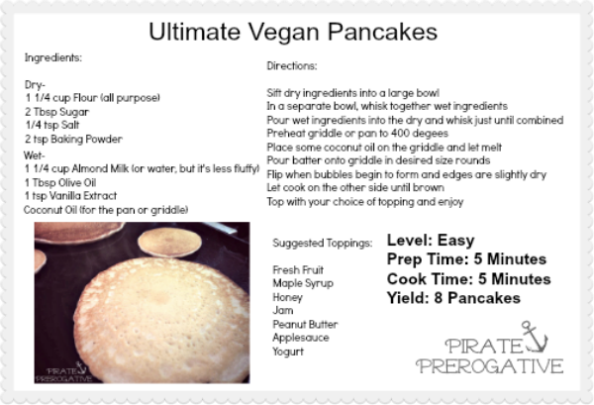
Program: The Cooking Analogy
We write recipes to tell humans how to cook
Can think of a program as a recipe for a computer
Notes:
Have to be specific to get the right outcome

Slide 5
Programming Ingredients
All programming languages have basic elements:
  Variables
  Expressions/Syntax
  Control Structures
  Data Structures
Notes:
Have to be specific to get the right outcome

Slide 6
Programming Ingredients
All programming languages have basic elements:
  Variables
  Expressions/Syntax
  Control Structures
  Data Structures
Notes:
Have to be specific to get the right outcome

Slide 7
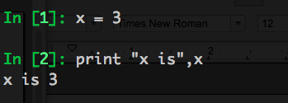
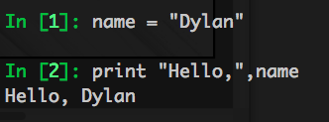
Variables
In computer programming, a variable is a storage location and an associated symbolic name which contains some known or unknown quantity or information, a value.
Notes:
Have to be specific to get the right outcome

Slide 8

Variables
Variable is how you can store information and then retrieve that information at some later point in time.
Notes:
Have to be specific to get the right outcome

Slide 9
Variables
Variables have specific types
Common types of variables:
  Integers (e.g. 12345)
  Floating point (e.g. 12.345)
  Boolean (e.g. True or False)
  String (e.g. “hello”)
Variable assignment
  x = 3.14159
  x <- 3.14159
Notes:
Have to be specific to get the right outcome

Slide 10
Programming Ingredients
All programming languages have basic elements:
  Variables
  Expressions/Syntax
  Control Structures
  Data Structures
Notes:
Have to be specific to get the right outcome

Slide 11
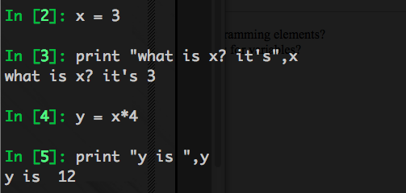
Expressions
Expressions compute new values from old ones.
Notes:
Have to be specific to get the right outcome

Slide 12
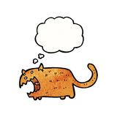
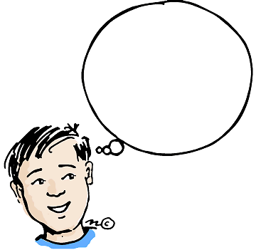
Expressions
Variables and expressions may have types, indicating the nature of the expected values.
x = 3
y = x*2
x = “hello”
y = x*2
Of course,
y is now 6
whaaa?!
Of course,
y is now 6
Notes:
Have to be specific to get the right outcome

Slide 13
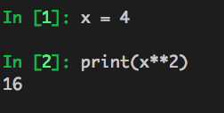
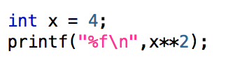
Expressions + Syntax
The method for declaring variables and expressions will vary depending on the programming language
python
c
Notes:
Have to be specific to get the right outcome

Slide 14
Expressions + Operators
Addition, Subtraction, Multiplication and division (+,-,*,/)

Slide 15
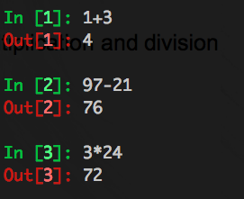
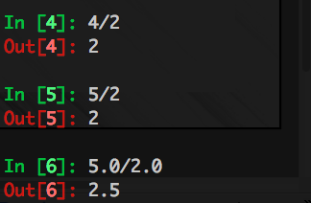
Expressions + Operators
Addition, Subtraction, Multiplication and division (+,-,*,/)

Slide 16
Syntax
“In my opinion as a veteran programmer, syntax is the one thing that will discourage you from learning to program. It takes practice and patience to understand, but I promise you, it will become second nature in time.”
The basic elements will be the same so once you learn one language the lessons can be easily transferred

Slide 17

More on syntax as we go
Notes:
Have to be specific to get the right outcome

Slide 18
Programming Ingredients
All programming languages have basic elements:
  Variables
  Expressions/Syntax
  Control Structures
  Data Structures
Notes:
Have to be specific to get the right outcome

Slide 19
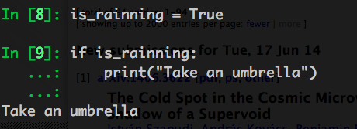
Control Structures
A control structure is a block of programming that analyzes variables and chooses a direction in which to go based on given parameters.
Notes:
Have to be specific to get the right outcome

Slide 20
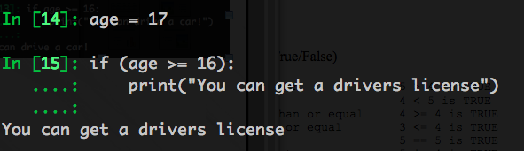
Control Structures: Conditionals
Conditionals which can be used to determine whether some condition is true
Less than | 2 < 3 is TRUE
Greater than | 3 > 2 is TRUE
Less or equal | 3 <= 3 is TRUE
Greater or equal | 10 >= 3 is TRUE
Equal | 3==3 is TRUE
Not Equal | 4!=5 is TRUE
Notes:
Have to be specific to get the right outcome

Slide 21
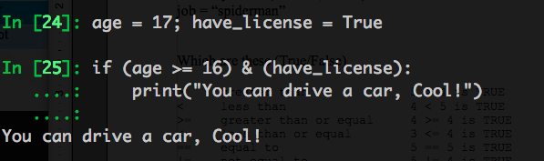
Control Structures: Conditionals
Add additional logic to evaluate parameters
Less than | 2 < 3 is TRUE
Greater than | 3 > 2 is TRUE
Less or equal | 3 <= 3 is TRUE
Greater or equal | 10 >= 3 is TRUE
Equal | 3==3 is TRUE
Not Equal | 4!=5 is TRUE
And | TRUE && TRUE
Or | TRUE || FALSE
Not | ~FALSE, !FALSE
Notes:
Have to be specific to get the right outcome

Slide 22
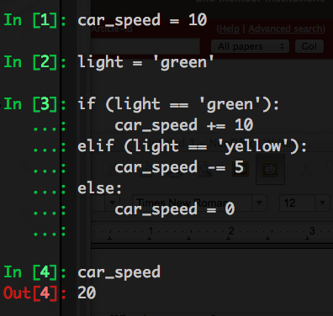
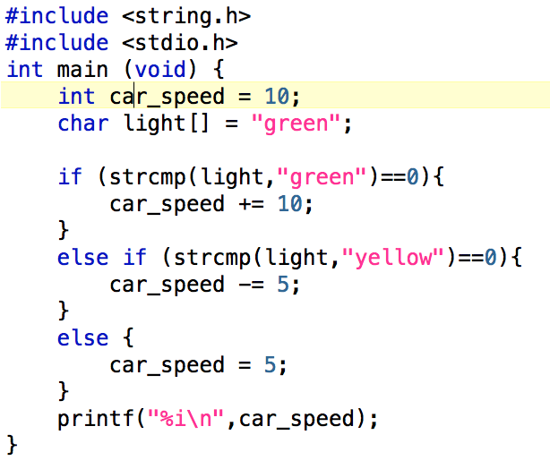
Control Structures: Conditionals
If...elseif...else...
Notes:
Have to be specific to get the right outcome

Slide 23
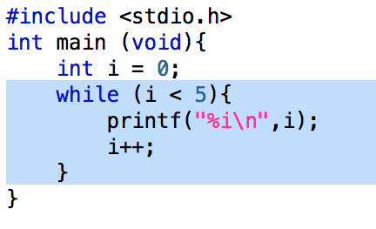
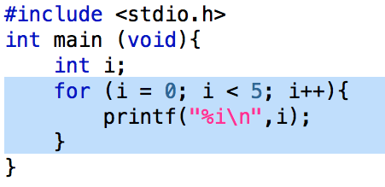
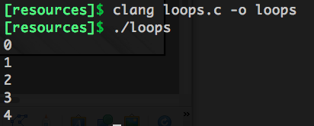
Control Structures: Loops
A sequence of several statements might be repeated over and over, until some condition is met; this is called a loop.
Notes:
Have to be specific to get the right outcome

Slide 24
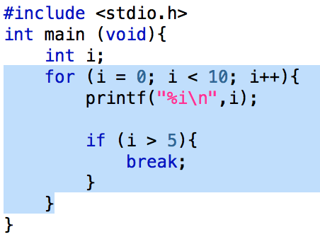
Control Structures: Loops
Can combine loops and conditionals to control the flow of a program
Notes:
Have to be specific to get the right outcome

Slide 25
Programming Ingredients
All programming languages have basic elements:
  Variables
  Expressions/Syntax
  Control Structures
  Data Structures
Notes:
Have to be specific to get the right outcome

Slide 26
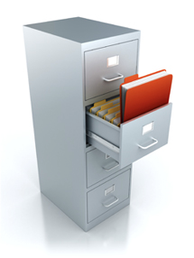
Data Structures
In computer science, a data structure is a particular way of storing and organizing data in a computer so that it can be used efficiently.
Notes:
Have to be specific to get the right outcome

Slide 27
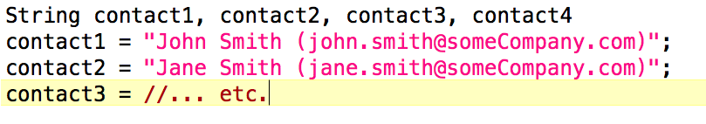
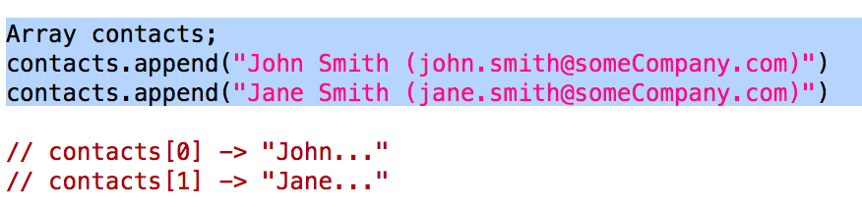
Data Structures: Case Study
In this case you want to store many contacts, though you're not sure exactly how many
Instead you should use an array or list

Slide 28
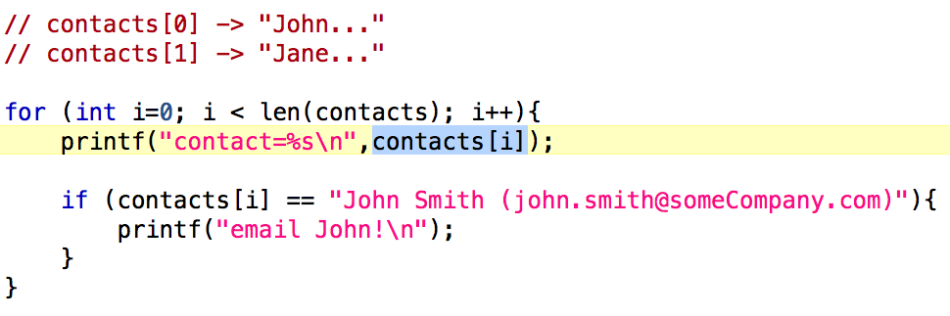
Data Structures: Case Study
Data structures:
  Cut down on the sheer amount of text
  Add flexibility to code
  Makes code more robust

Slide 29
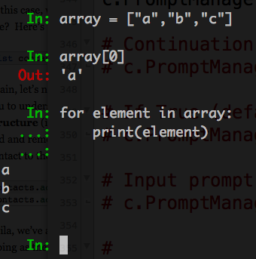
Data Structures
Arrays/Lists : An ordered collection of elements.
C-type languages start counting at 0, fortran starts at 1

Slide 30
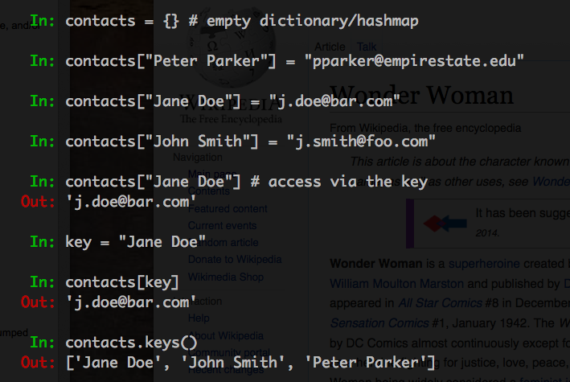
Data Structures
HashMap/Dictionary : Maps a key to value.

Slide 31
Intermission

Slide 32
Functions
An entire set of statements, declarations, and control flow constructs can be lumped together into a function (also called routine, subroutine, or procedure) which another piece of code can then call as a unit.

Slide 33
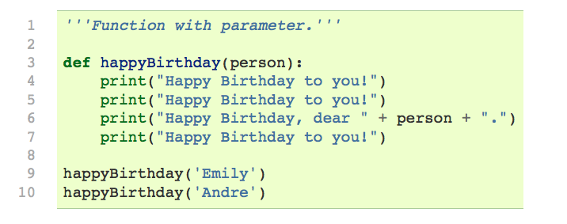
Functions
Example of happy birthday function

Slide 34
Functions
Use functions when you have a unit of code you want to call again, perhaps with slightly different parameters

Slide 35
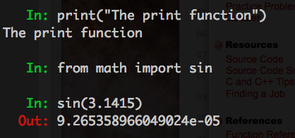
Libraries
Collection of functions and variables which can be included into your program.

Slide 36
Program
A set of functions, global variables, and other elements makes up a program.

Slide 37
Cooking Analogy

Slide 38
Quiz Time
Point your browser at the location:
bit.ly/1ly1CYJ

